Slide 1


Big Data Infrastructure
CS 489/698 Big Data Infrastructure (Winter 2017)
Week 3: From MapReduce to Spark (2/2)
January 19, 2017
Jimmy Lin
David R. Cheriton School of Computer Science
University of Waterloo
These slides are available at http://lintool.github.io/bigdata-2017w/
This work is licensed under a Creative Commons Attribution-Noncommercial-Share Alike 3.0 United States See http://creativecommons.org/licenses/by-nc-sa/3.0/us/ for details

Slide 2

Source: Wikipedia (The Scream)

Slide 3
An Apt Quote
All problems in computer science can be solved
by another level of indirection... Except for the
problem of too many layers of indirection.
- David Wheeler

Slide 4

The datacenter is the computer!
What’s the instruction set?
What are the abstractions?
Source: Google

Slide 5
MapReduce
List[(K1,V1)]
map f: (K1, V1) ⇒ List[(K2, V2)]
reduce g: (K2, Iterable[V2]) ⇒ List[(K3, V3)]
List[K3,V3])

Slide 6
Spark
RDD[T]
RDD[(K, V)]
RDD[(K, V)]
RDD[T]
RDD[T]
RDD[T]
RDD[(K, V)]
flatMap f: (T) ⇒ TraversableOnce[U]
groupByKey
aggregateByKey
seqOp: (U, V) ⇒ U, combOp: (U, U) ⇒ U
map f: (T) ⇒ U
filter f: (T) ⇒ Boolean
mapPartitions f: (Iterator[T]) ⇒ Iterator[U]
RDD[(K, V)]
RDD[(K, W)]
reduceByKey
f: (V, V) ⇒ V
RDD[(K, V)]
RDD[(K, V)]
RDD[(K, W)]
RDD[U]
RDD[(K, Iterable[V])]
RDD[(K, U)]
RDD[U]
sort
RDD[U]
cogroup
RDD[U]
RDD[(K, V)]
join
And more!
RDD[(K, (Iterable[V], Iterable[W]))]
RDD[(K, V)]
RDD[(K, (V, W))]

Slide 7
Spark Word Count
val textFile = sc.textFile(args.input())
textFile
.flatMap(line => tokenize(line))
.map(word => (word, 1))
.reduceByKey((x, y) => x + y)
.saveAsTextFile(args.output())
RDD[T]
??
flatMap f: (T) ⇒ TraversableOnce[U]
RDD[U]

Slide 8
What’s an RDD?
Resilient Distributed Dataset (RDD)
= immutable
= partitioned
Wait, so how do you actually do anything?
Developers define transformations on RDDs
Framework keeps track of lineage

Slide 9
RDD Lifecycle
Transformation
RDD
Action
values
Transformations are lazy:
Framework keeps track of lineage
Actions trigger actual execution

Slide 10
Spark Word Count
RDDs
val textFile = sc.textFile(args.input())
val a = textFile.flatMap(line => line.split(" "))
val b = a.map(word => (word, 1))
val c = b.reduceByKey((x, y) => x + y)
c.saveAsTextFile(args.output())
Transformations
Action

Slide 11
RDDs and Lineage
On HDFS
textFile: RDD[String]
.flatMap(line => line.split(" "))
a: RDD[String]
.map(word => (word, 1))
b: RDD[(String, Int)]
.reduceByKey((x, y) => x + y)
c: RDD[(String, Int)]
Action!
Remember, transformations are lazy!

Slide 12
RDDs and Optimizations
Lazy evaluation creates optimization opportunities
On HDFS
textFile: RDD[String]
RDDs don’t need to be materialized!
.flatMap(line => line.split(" "))
a: RDD[String]
Want MM?
.map(word => (word, 1))
b: RDD[(String, Int)]
.reduceByKey((x, y) => x + y)
c: RDD[(String, Int)]
Action!

Slide 13
RDDs and Caching
RDDs can be materialized in memory (and on disk)!
On HDFS
textFile: RDD[String]
✗
.flatMap(line => line.split(" "))
Cache it!
a: RDD[String]
Fault tolerance?
.map(word => (word, 1))
b: RDD[(String, Int)]
.reduceByKey((x, y) => x + y)
c: RDD[(String, Int)]
Action!
Spark works even if the RDDs are partially cached!

Slide 14
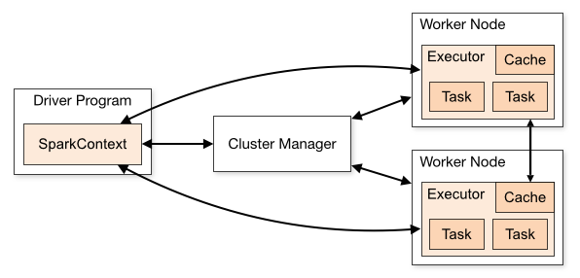
Spark Architecture

Slide 15
Compare
namenode
job submission node
namenode daemon
jobtracker
tasktracker
tasktracker
tasktracker
datanode daemon
datanode daemon
datanode daemon
Linux file system
Linux file system
Linux file system
…
…
…
slave node
slave node
slave node

Slide 16
An Apt Quote
All problems in computer science can be solved
by another level of indirection... Except for the
problem of too many layers of indirection.
- David Wheeler

Slide 17
YARN
Hadoop’s (original) limitations:
Can only run MapReduce
What if we want to run other distributed frameworks?
YARN = Yet-Another-Resource-Negotiator
Provides API to develop any generic distributed application
Handles scheduling and resource request
MapReduce (MR2) is one such application in YARN

Slide 18
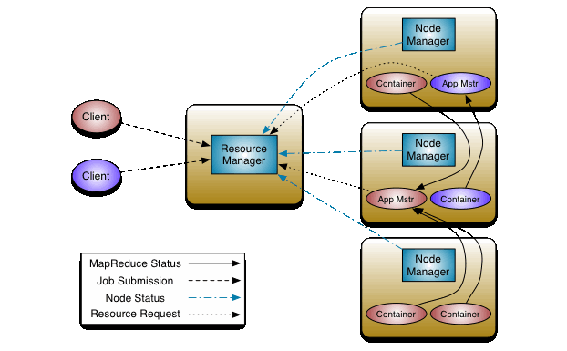
YARN

Slide 19
Spark Programs
Scala, Java, Python, R
spark-shell
spark-submit
Your application
(driver program)
SparkContext
Spark context: tells the framework where to find the cluster
Cluster manager
Local threads
Use the Spark context to create RDDs
Worker
Worker
Spark executor
Spark executor
HDFS

Slide 20
Spark Driver
spark-shell
spark-submit
Your application
(driver program)
val textFile =
sc.textFile(args.input())
textFile
.flatMap(line => tokenize(line))
.map(word => (word, 1))
.reduceByKey((x, y) => x + y)
.saveAsTextFile(args.output())
SparkContext
Cluster manager
Local threads
Worker
Worker
Spark executor
Spark executor
What’s happening to the functions?
HDFS

Slide 21
Spark Driver
spark-shell
spark-submit
Your application
(driver program)
val textFile =
sc.textFile(args.input())
textFile
.flatMap(line => tokenize(line))
.map(word => (word, 1))
.reduceByKey((x, y) => x + y)
.saveAsTextFile(args.output())
SparkContext
Cluster manager
Local threads
Worker
Worker
Note: you can run code “locally”, integrate cluster-computed values!
Spark executor
Spark executor
Beware of the collect action!
HDFS

Slide 22
Spark Transformations
RDD[T]
RDD[(K, V)]
RDD[(K, V)]
RDD[T]
RDD[T]
RDD[T]
RDD[(K, V)]
flatMap f: (T) ⇒ TraversableOnce[U]
groupByKey
aggregateByKey
seqOp: (U, V) ⇒ U, combOp: (U, U) ⇒ U
map f: (T) ⇒ U
filter f: (T) ⇒ Boolean
mapPartitions f: (Iterator[T]) ⇒ Iterator[U]
RDD[(K, V)]
RDD[(K, W)]
reduceByKey
f: (V, V) ⇒ V
RDD[(K, V)]
RDD[(K, V)]
RDD[(K, W)]
RDD[U]
RDD[(K, Iterable[V])]
RDD[(K, U)]
RDD[U]
sort
RDD[U]
cogroup
RDD[U]
RDD[(K, V)]
join
RDD[(K, (Iterable[V], Iterable[W]))]
RDD[(K, V)]
RDD[(K, (V, W))]

Slide 23
Starting Points
Input File
Input File
InputSplit
InputSplit
InputSplit
InputSplit
InputSplit
InputFormat
RecordReader
RecordReader
RecordReader
RecordReader
RecordReader
“mapper”
“mapper”
“mapper”
“mapper”
“mapper”
Source: redrawn from a slide by Cloduera, cc-licensed

Slide 24
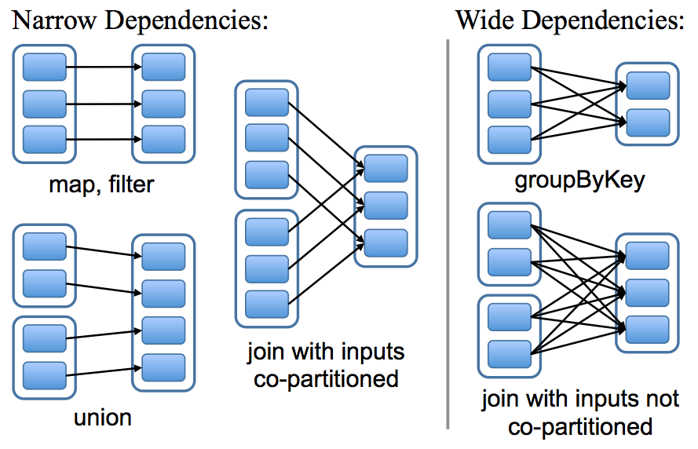
Physical Operators

Slide 25
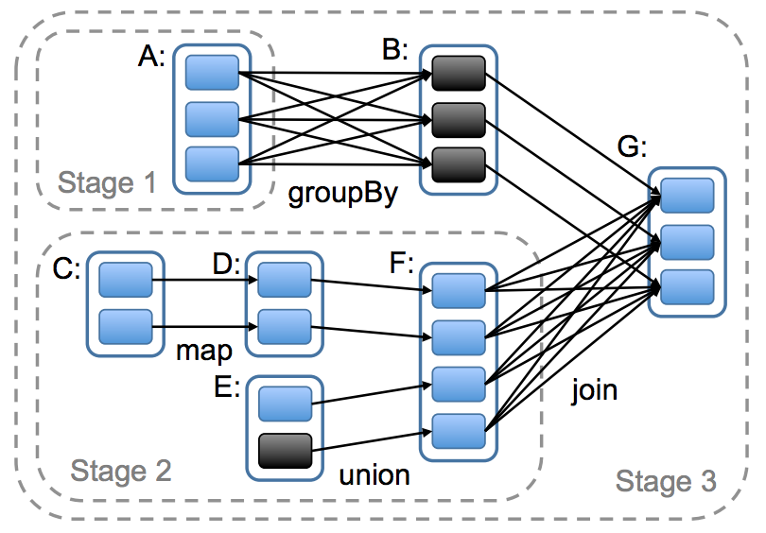
Execution Plan
Wait, where have we seen this before?

Slide 26
Pig: Example Script
visits = load ‘/data/visits’ as (user, url, time);
gVisits = group visits by url;
visitCounts = foreach gVisits generate url, count(visits);
urlInfo = load ‘/data/urlInfo’ as (url, category, pRank);
visitCounts = join visitCounts by url, urlInfo by url;
gCategories = group visitCounts by category;
topUrls = foreach gCategories generate top(visitCounts,10);
store topUrls into ‘/data/topUrls’;
Pig Slides adapted from Olston et al. (SIGMOD 2008)

Slide 27
Pig Query Plan
load visits
group by url
foreach url
generate count
load urlInfo
join on url
group by category
foreach category
generate top(urls, 10)
Pig Slides adapted from Olston et al. (SIGMOD 2008)

Slide 28
Pig: MapReduce Execution
load visits
Map₁
group by url
Reduce₁
Map₂
foreach url
generate count
load urlInfo
join on url
Reduce₂
group by category
Map₃
Reduce₃
foreach category
generate top(urls, 10)
Pig Slides adapted from Olston et al. (SIGMOD 2008)

Slide 29
Execution Plan
Kinda like a sequence of MapRedue jobs?

Slide 30
Can’t avoid this!
…
…
But, what’s the major difference?

Slide 31
Remember this?
Mapper
intermediate files (on disk)
merged spills (on disk)
Combiner
Reducer
circular buffer (in memory)
Combiner
other reducers
spills (on disk)
other mappers

Slide 32
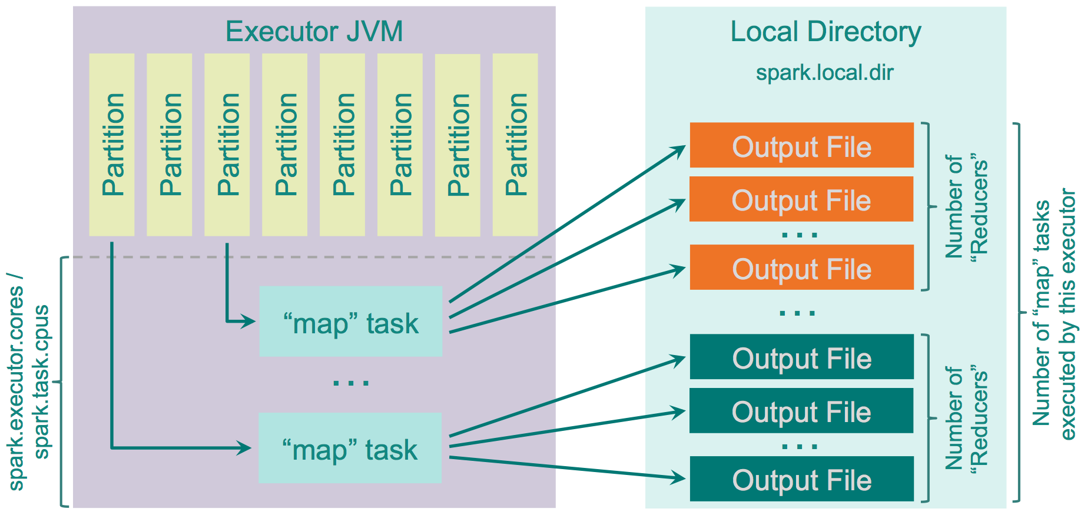
Spark Shuffle Implementations
Hash shuffle
What happened to sorting?
Source: http://0x0fff.com/spark-architecture-shuffle/

Slide 33
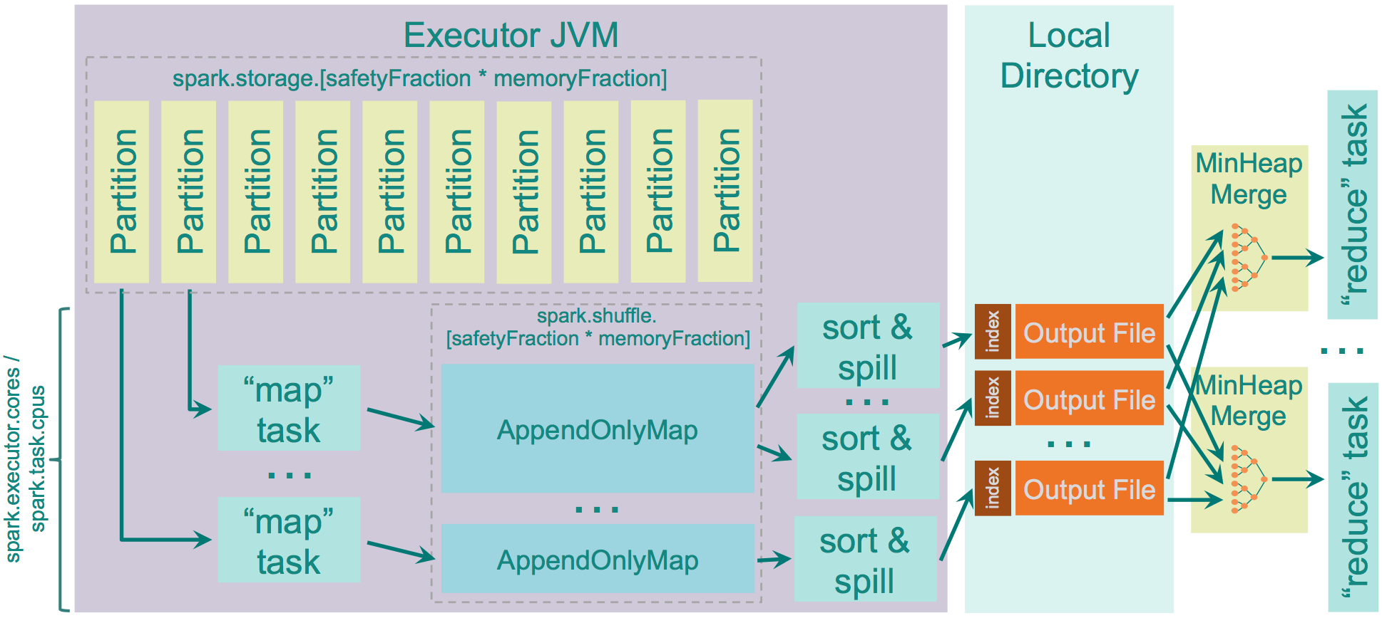
Spark Shuffle Implementations
Sort shuffle
Source: http://0x0fff.com/spark-architecture-shuffle/

Slide 34
Remember this?
Mapper
intermediate files (on disk)
merged spills (on disk)
Combiner
Reducer
circular buffer (in memory)
Combiner
other reducers
spills (on disk)
other mappers
Where are the combiners in Spark?

Slide 35
Reduce-like Operations
RDD[(K, V)]
RDD[(K, V)]
reduceByKey
f: (V, V) ⇒ V
aggregateByKey
seqOp: (U, V) ⇒ U, combOp: (U, U) ⇒ U
RDD[(K, V)]
RDD[(K, U)]
What happened to combiners?
…
…

Slide 36
Spark #wins
Richer operators
RDD abstraction supports optimizations (pipelining, caching, etc.)
Scala, Java, Python, R, bindings

Slide 37
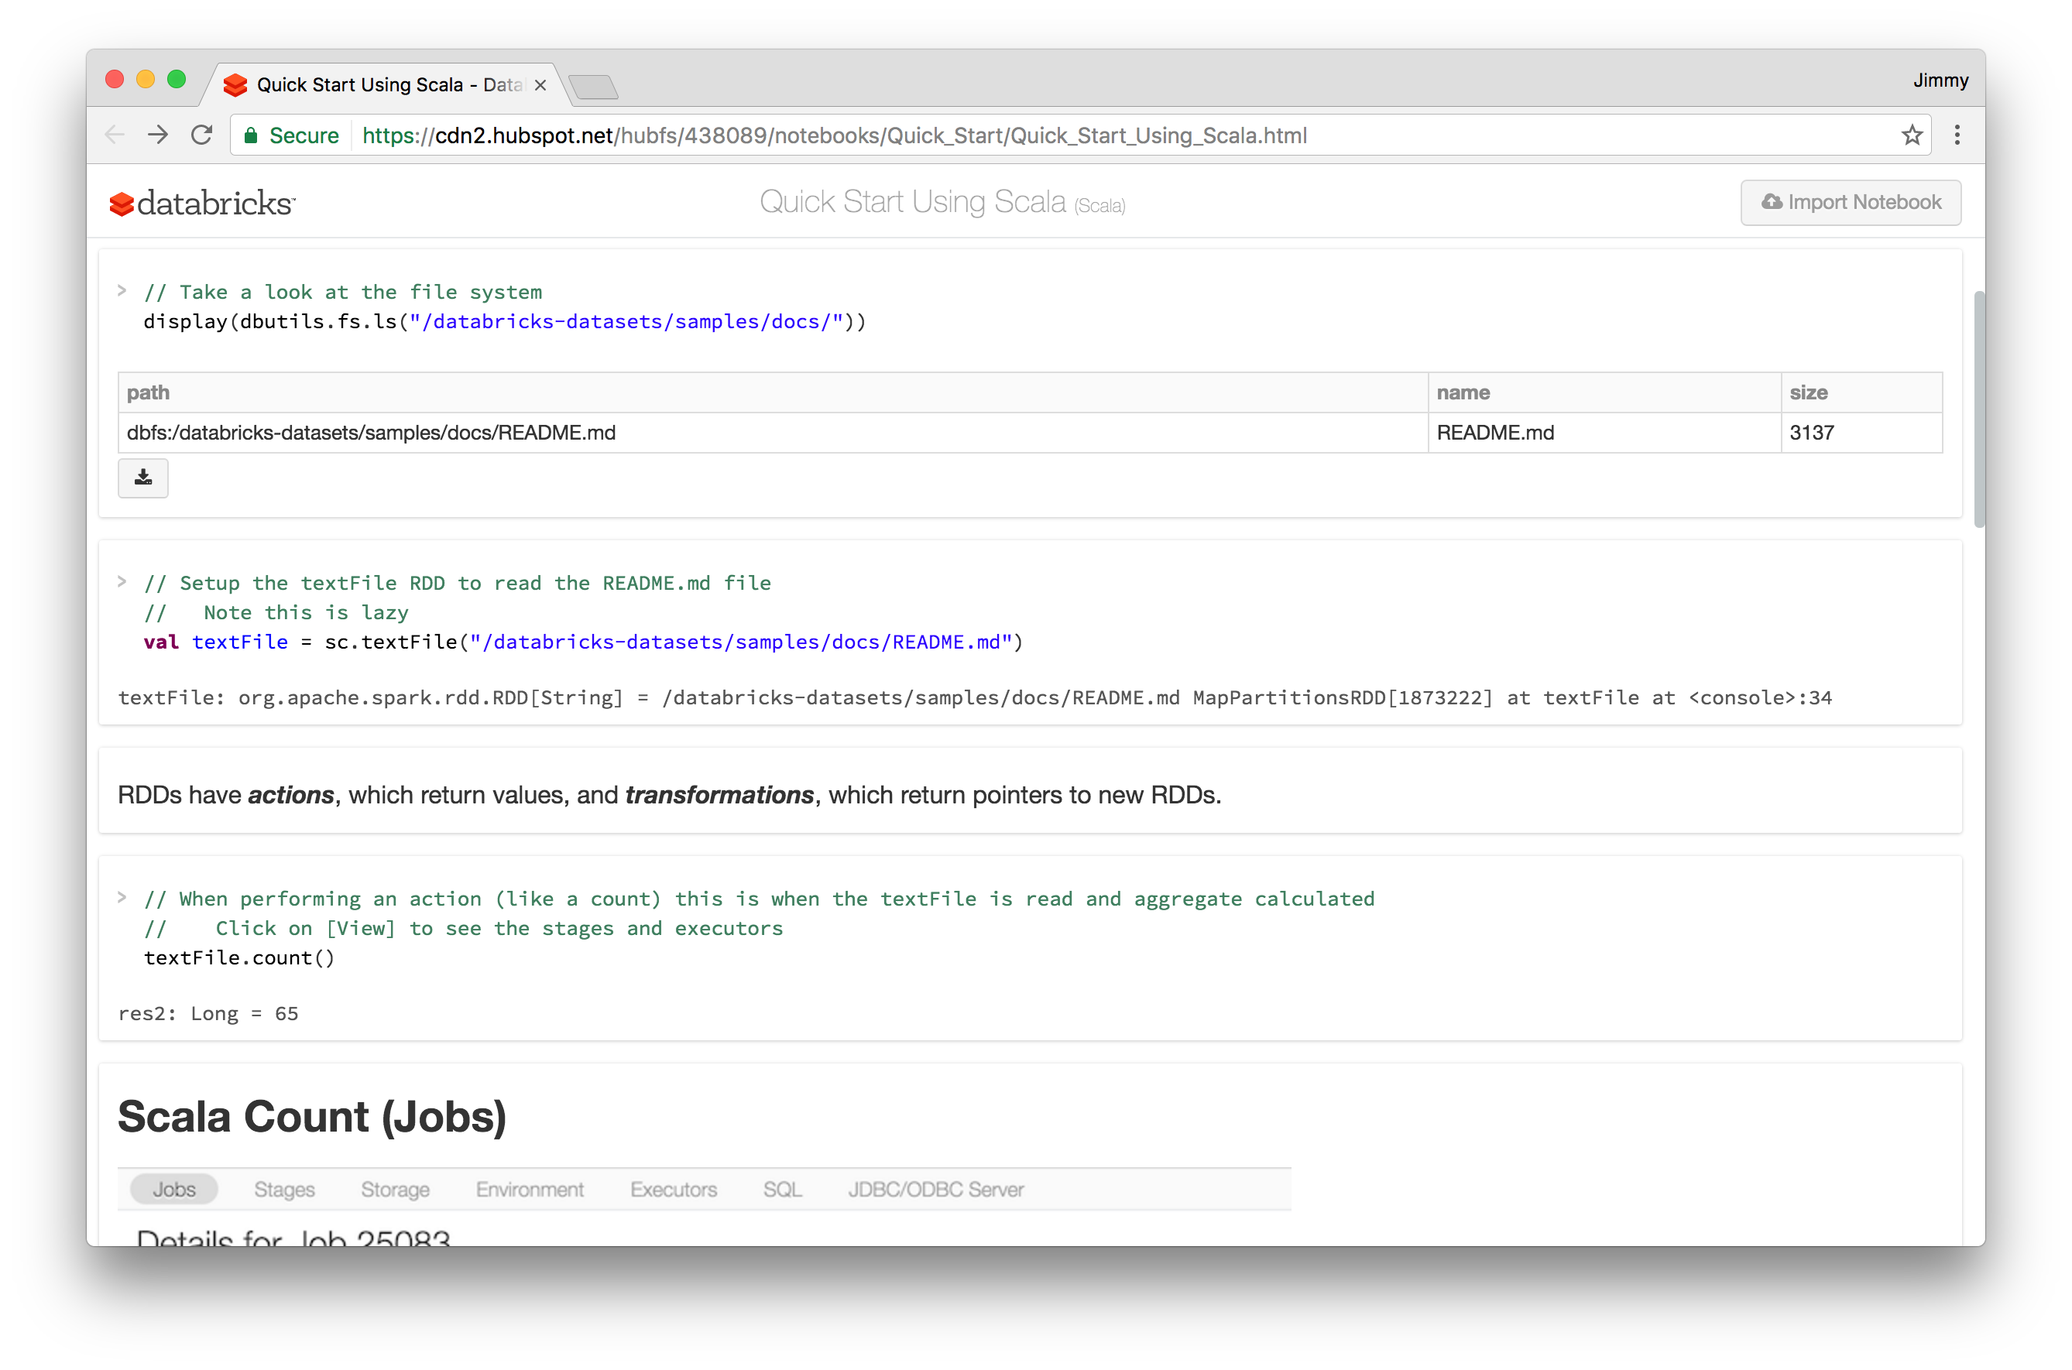
Spark #wins

Slide 38
Spark #lose
Java serialization (w/ Kryo optmizations)
Scala: poor support for primitives

Slide 39
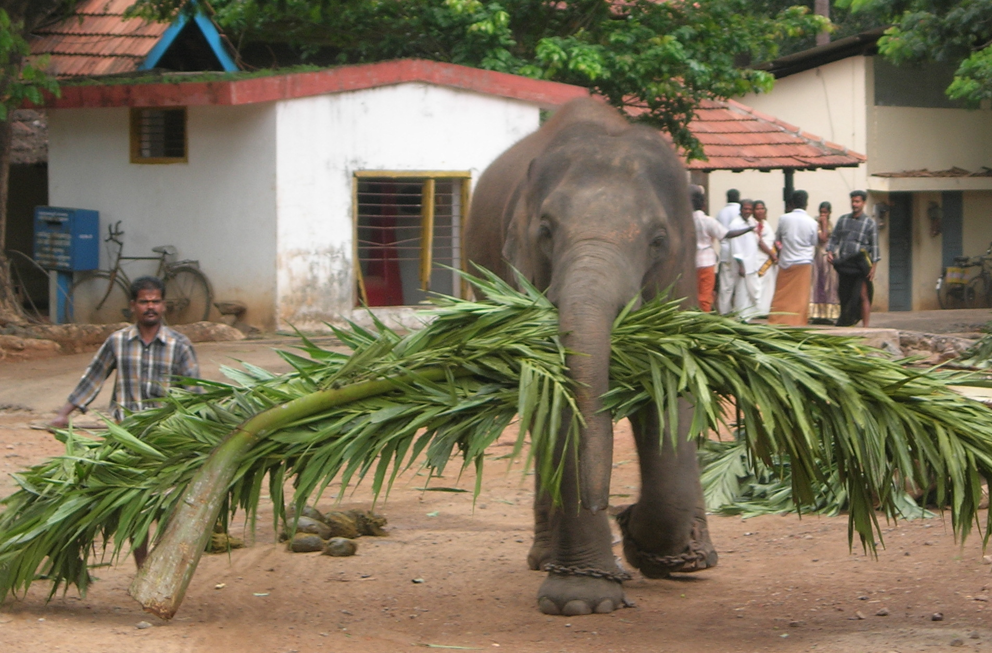
Algorithm design, redux
Source: Wikipedia (Mahout)

Slide 40

Two superpowers:
Associativity
Commutativity
(sorting)
What follows… very basic category theory…

Slide 41
The Power of Associativity
You can put parentheses where ever you want!
v₁ ⊕ v₂ ⊕ v₃ ⊕ v₄ ⊕ v₅ ⊕ v₆ ⊕ v₇ ⊕ v₈ ⊕ v₉
v₁ ⊕ v₂ ⊕ v₃ ⊕ v₄ ⊕ v₅ ⊕ v₆ ⊕ v₇ ⊕ v₈ ⊕ v₉
v₁ ⊕ v₂ ⊕ v₃ ⊕ v₄ ⊕ v₅ ⊕ v₆ ⊕ v₇ ⊕ v₈ ⊕ v₉
Credit to Oscar Boykin for the idea behind these slides

Slide 42
The Power of Commutativity
You can swap order of operands however you want!
v₁ ⊕ v₂ ⊕ v₃ ⊕ v₄ ⊕ v₅ ⊕ v₆ ⊕ v₇ ⊕ v₈ ⊕ v₉
v₄ ⊕ v₅ ⊕ v₆ ⊕ v₇ ⊕ v₁ ⊕ v₂ ⊕ v₃ ⊕ v₈ ⊕ v₉
v₈ ⊕ v₉ ⊕ v₄ ⊕ v₅ ⊕ v₆ ⊕ v₇ ⊕ v₁ ⊕ v₂ ⊕ v₃

Slide 43
Implications for distributed processing?
You don’t know when the tasks begin
You don’t know when the tasks end
You don’t know when the tasks interrupt each other
You don’t know when intermediate data arrive
…
It’s okay!

Slide 44
Word Count: Baseline
class Mapper {
def map(key: Long, value: Text, context: Context) = {
for (word <- tokenize(value)) {
context.write(word, 1)
}
}
}
class Reducer {
def reduce(key: Text, values: Iterable[Int], context: Context) = {
for (value <- values) {
sum += value
}
context.write(key, sum)
}
}

Slide 45
Fancy Labels for Simple Concepts…
Semigroup = ( M , ⊕ )
⊕ : M ✕ M → M, s.t., ∀m₁, m₂, m₃ ∋ M
(m₁ ⊕ m₂) ⊕ m₃ = m₁ ⊕ (m₂ ⊕ m₃)
Monoid = Semigroup + identity
ε s.t., ε ⊕ m = m ⊕ ε = m, ∀m ∋ M
Commutative Monoid = Monoid + commutativity
∀m₁, m₂ ∋ M, m₁ ⊕ m₂ = m₂ ⊕ m₁
A few examples?
(hint, previous slide!)

Slide 46
Back to these…
RDD[(K, V)]
RDD[(K, V)]
reduceByKey
f: (V, V) ⇒ V
aggregateByKey
seqOp: (U, V) ⇒ U, combOp: (U, U) ⇒ U
Wait, I’ve seen this before?
RDD[(K, V)]
RDD[(K, U)]

Slide 47

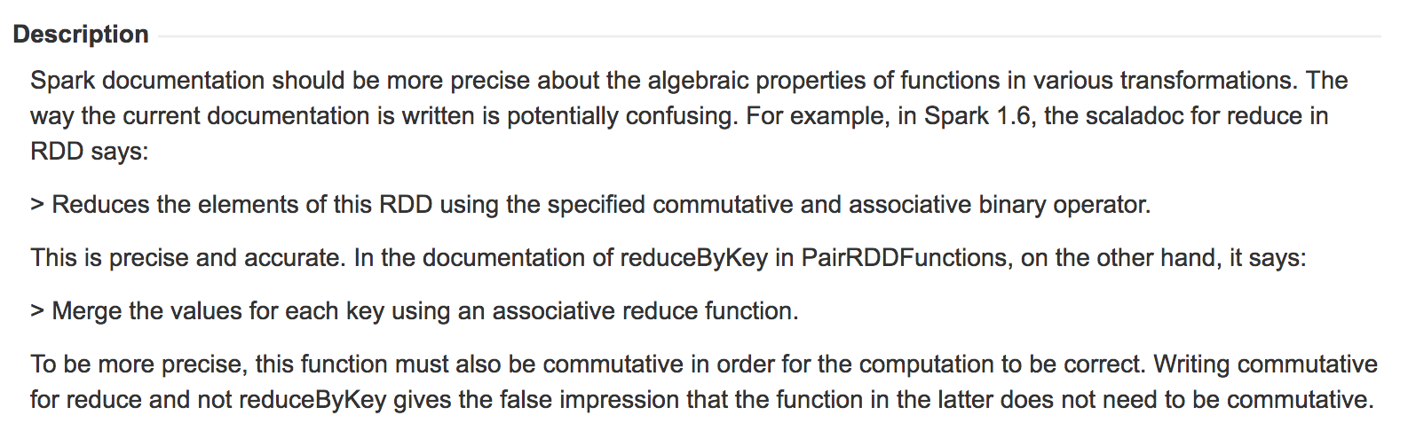

Slide 48
Computing the mean v1 (again)
class Mapper {
def map(key: Text, value: Int, context: Context) = {
context.write(key, value)
}
}
class Reducer {
def reduce(key: Text, values: Iterable[Int], context: Context) {
for (value <- values) {
sum += value
cnt += 1
}
context.write(key, sum/cnt)
}
}

Slide 49
Computing the mean v3 (again)
class Mapper {
def map(key: Text, value: Int, context: Context) =
context.write(key, (value, 1))
}
class Combiner {
def reduce(key: Text, values: Iterable[Pair], context: Context) = {
for (value <- values) {
sum += value.left
cnt += value.right
}
context.write(key, (sum, cnt))
}
}
class Reducer {
def reduce(key: Text, values: Iterable[Pair], context: Context) = {
for (value <- values) {
sum += value.left
cnt += value.right
}
context.write(key, sum/cnt)
}
}
Wait, I’ve seen this before?
RDD[(K, V)]
reduceByKey
f: (V, V) ⇒ V
RDD[(K, V)]

Slide 50
Co-occurrence Matrix: Stripes
class Mapper {
def map(key: Long, value: Text, context: Context) = {
for (u <- tokenize(value)) {
val map = new HashMap()
for (v <- neighbors(u)) {
map(v) += 1
}
context.write(u, map)
}
}
}
class Reducer {
def reduce(key: Text, values: Iterable[Map], context: Context) = {
val map = new HashMap()
for (value <- values) {
map += value
}
context.write(key, map)
}
}
Wait, I’ve seen this before?
RDD[(K, V)]
reduceByKey
f: (V, V) ⇒ V
RDD[(K, V)]

Slide 51
Computing the mean v2 (again)
class Mapper {
def map(key: Text, value: Int, context: Context) =
context.write(key, value)
}
class Combiner {
def reduce(key: Text, values: Iterable[Int], context: Context) = {
for (value <- values) {
sum += value
cnt += 1
}
context.write(key, (sum, cnt))
}
}
class Reducer {
def reduce(key: Text, values: Iterable[Pair], context: Context) = {
for (value <- values) {
sum += value.left
cnt += value.right
}
context.write(key, sum/cnt)
}
}
RDD[(K, V)]
aggregateByKey
seqOp: (U, V) ⇒ U, combOp: (U, U) ⇒ U
RDD[(K, U)]

Slide 52
Synchronization: Pairs vs. Stripes
Approach 1: turn synchronization into an ordering problem
Sort keys into correct order of computation
Partition key space so each reducer receives appropriate set of partial results
Hold state in reducer across multiple key-value pairs to perform computation
Illustrated by the “pairs” approach
Approach 2: data structures that bring partial results together
Each reducer receives all the data it needs to complete the computation
Illustrated by the “stripes” approach
Commutative monoids!

Slide 53
Because you can’t avoid this…
…
…
But commutative monoids help

Slide 54
Synchronization: Pairs vs. Stripes
Approach 1: turn synchronization into an ordering problem
Sort keys into correct order of computation
Partition key space so each reducer receives appropriate set of partial results
Hold state in reducer across multiple key-value pairs to perform computation
Illustrated by the “pairs” approach
What about this?
Approach 2: data structures that bring partial results together
Each reducer receives all the data it needs to complete the computation
Illustrated by the “stripes” approach
Commutative monoids!

Slide 55
f(B|A): “Pairs”
(a, *) → 32
Reducer holds this value in memory
(a, b₁) → 3
(a, b₂) → 12
(a, b₃) → 7
(a, b₄) → 1
…
(a, b₁) → 3 / 32
(a, b₂) → 12 / 32
(a, b₃) → 7 / 32
(a, b₄) → 1 / 32
…
For this to work:
Emit extra (a, *) for every b_{n} in mapper
Make sure all a’s get sent to same reducer (use partitioner)
Make sure (a, *) comes first (define sort order)
Hold state in reducer across different key-value pairs

Slide 56
Two superpowers:
Associativity
Commutativity
(sorting)

Slide 57
When you can’t “monoidify”
…
…
Sequence your computations by sorting

Slide 58
An Apt Quote
All problems in computer science can be solved
by another level of indirection... Except for the
problem of too many layers of indirection.
- David Wheeler

Slide 59
The datacenter is the computer!
What’s the instruction set?
What are the abstractions?
Source: Google

Slide 60

Algorithm design in a nutshell…
Exploit associativity and commutativity via commutative monoids (if you can)
Exploit framework-based sorting to sequence computations (if you can’t)
Source: Wikipedia (Walnut)

Slide 61

Questions?
Source: Wikipedia (Japanese rock garden)

